Slide 1
Gas detecting Alarm system using Arduino
An Internet Of Things Project
This Project is done in TinkerCad
https://www.tinkercad.com/dashboard

Slide 2
INTRODUCTION
This system can be used by operators in the area where the leak is occurring can be alerted by a gas detector, giving them the chance to evacuate. Because many gases may be hazardous to biological life, such as people or animals, this sort of equipment is essential. Increased levels of these gases in the atmosphere will be highly hazardous. These gases may be combustible at particular temperatures and humidity levels, toxic once they exceed the required limits, or a contributing element in an area's air quality, creating issues like smog and impaired visibility, which can lead to significant injuries and even harm to people's health. Many civilizations have built-in firefighting systems.

Slide 3
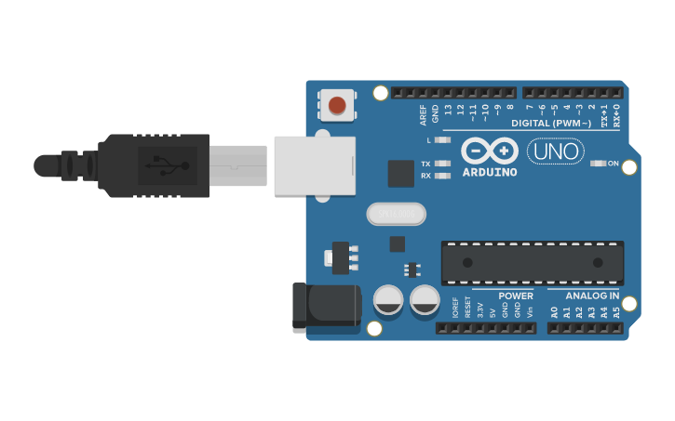
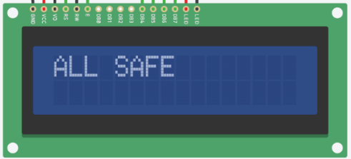
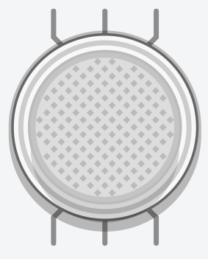
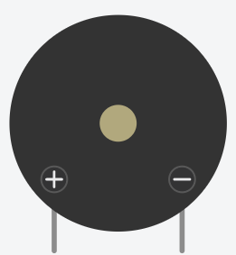
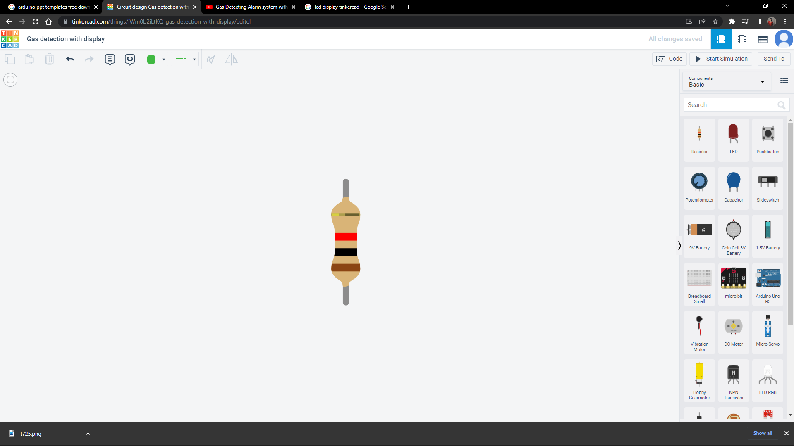
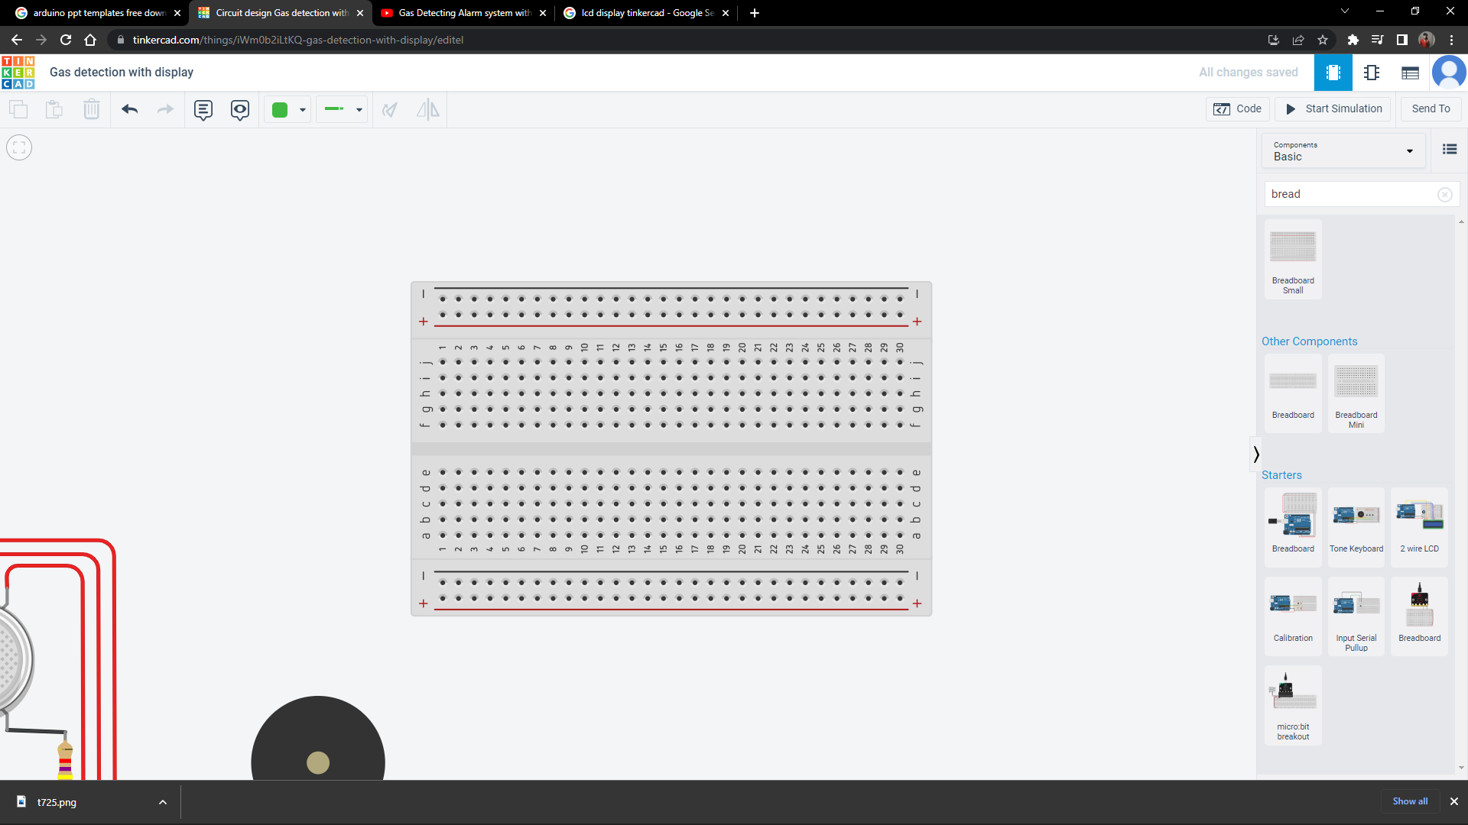
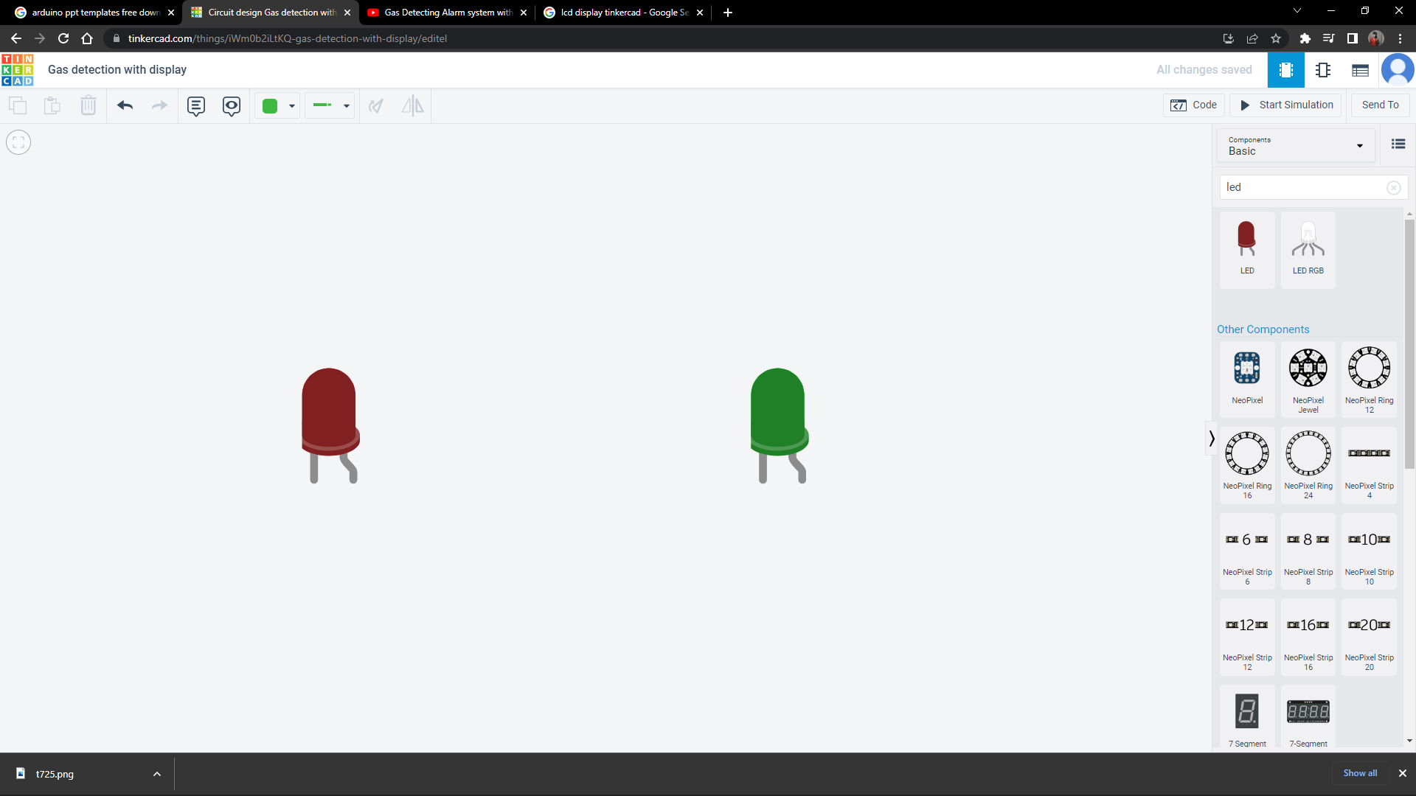
COMPONENTS USED
ARDUINO UNO R3
LCD display 16 x 2
Breadboard
Gas Sensor
Piezo Speaker
LED light
Resistor

Slide 4



ARDUINO UNO R3
BREADBOARD
LCD DISPLAY 16 x 2
Arduino UNO is a microcontroller board based on the ATmega328P. It has 14 digital input/output pins (of which 6 can be used as PWM outputs), 6 analog inputs, a 16 MHz ceramic resonator, a USB connection, a power jack, an ICSP header and a reset button. It contains everything needed to support the microcontroller; simply connect it to a computer with a USB cable or power it with a AC-to-DC adapter or battery to get started. You can tinker with your UNO without worrying too much about doing something wrong, worst case scenario you can replace the chip for a few dollars and start over again.
The rows of a solderless breadboard are connected inside, allowing you to connect components by plugging them into the same row as each other. Hover your cursor over points in the virtual breadboard to highlight their connections. The special long rails along the edges are for easy access to power and ground. It’s a best practice to always connect 5V and ground to these long rails as a starting point for any Arduino circuit.
An LCD (Liquid Crystal Display) screen is an electronic display module and has a wide range of applications. A 16x2 LCD display is very basic module and is very commonly used in various devices and circuits. A 16x2 LCD means it can display 16 characters per line and there are 2 such lines. The 16 x 2 intelligent alphanumeric dot matrix display is capable of displaying 224 different characters and symbols. This LCD has two registers, namely, Command and Data.

Slide 5


GAS SENSOR
LED LIGHTS & RESISTORS
PIEZO SPEAKER
Gas detector is designed and stimulated with the help of Tinker Cad. MQ2 is a gas sensor used for gas leakage detect... The gas detector in the circuit is used to detect the smoke. If smoke is present, it switches on the fire alarm (Buzzer)
A piezo is an electronic device that generates a voltage when it's physically deformed by a vibration, sound wave, or mechanical strain. Similarly, when you put a voltage across a piezo, it vibrates and creates a tone. Piezos can be used both to play tones and to detect tones.
LED (Light Emitting Diode) is an electronic device, which emits light when the current passes through its terminals. LED's are used in various applications. It is also used as an ON/OFF indicator in different electronic devices.

Slide 6
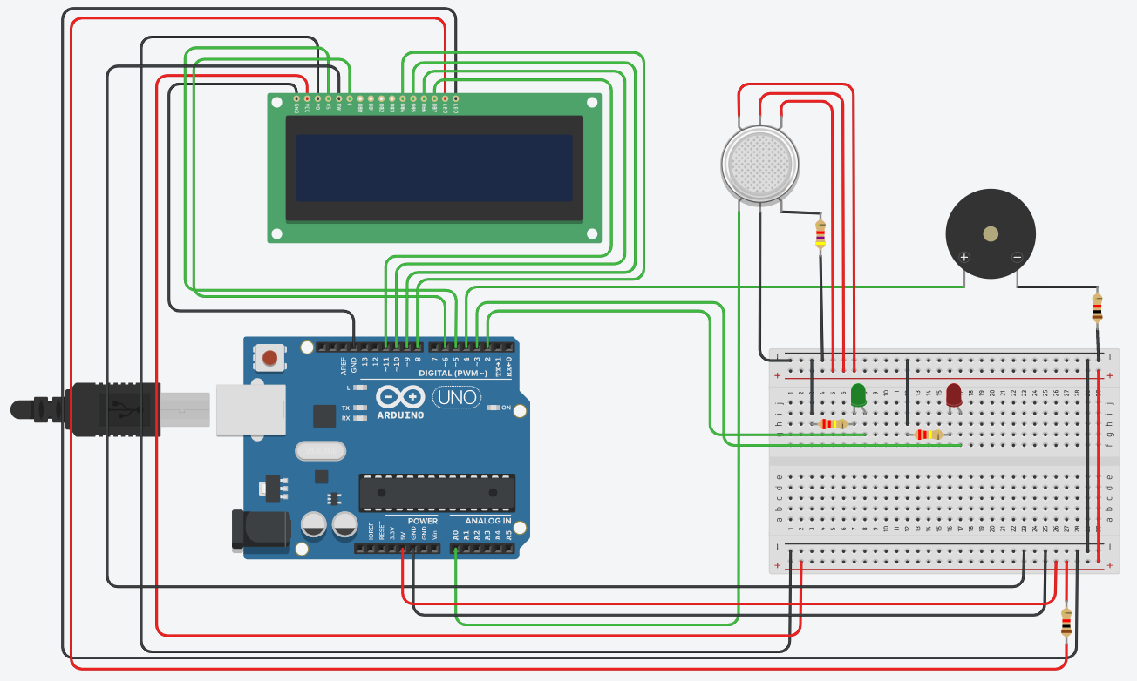
WORKING OF THE SYSTEM
Firstly, the system is turned ON the green LED light is also turned ON stating the environment/room is safe right now.

Slide 7
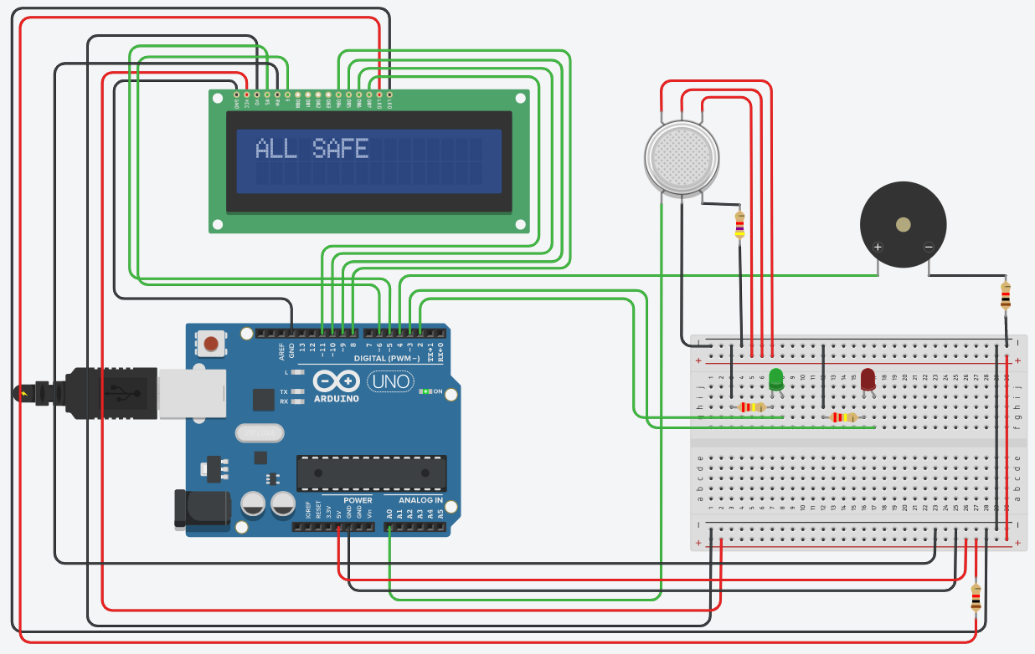
An “ALL SAFE !! ALL CLEAR !!” message is displayed on the LCD display of the device.

Slide 8
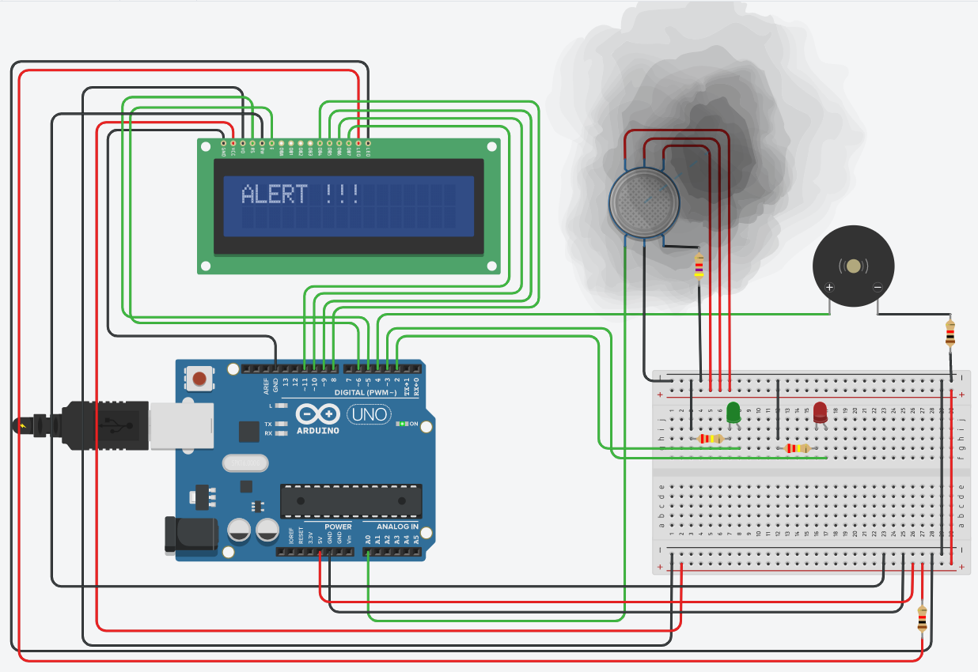
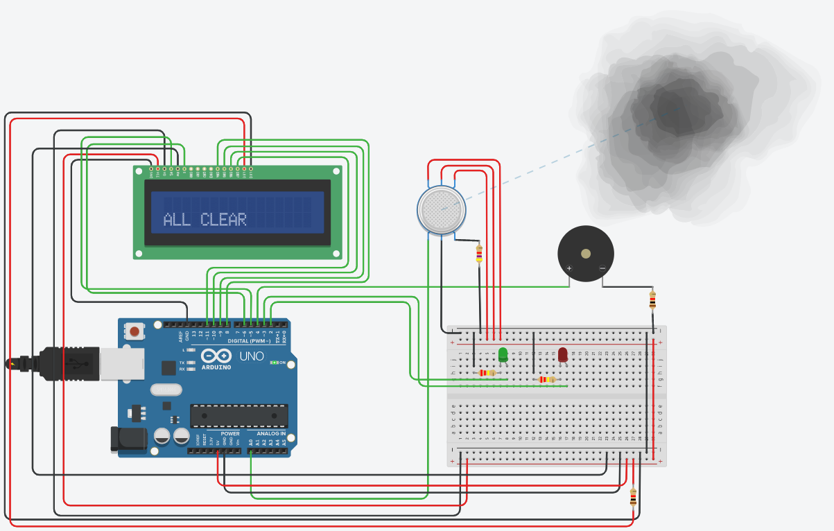
Then whenever the Gas Sensor MQ- 2 in this device detects a gas leaks or other emissions that can interface with a control systems the Green LED light turns OFF and a red LED light is turned ON.

Slide 9

As soon as this happens , the Piezo Speaker starts to buzz with a high tone beep and a message on the LCD is displayed “ALERT !!! EVACUATE ASAP ! ”

Slide 10
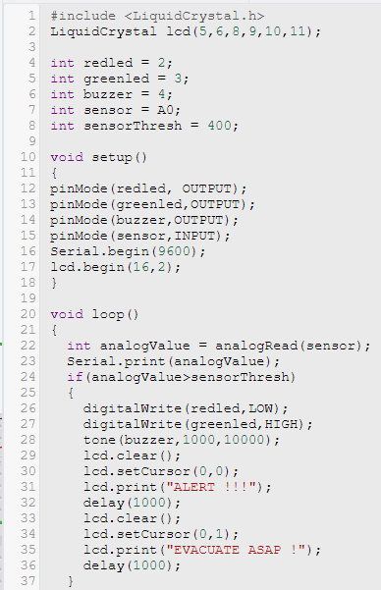
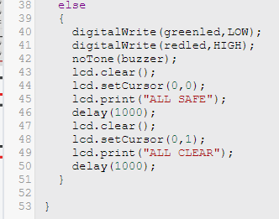
Program Code for the Gas Detection System :

Slide 11
Thanking
You
Internet Of Things (IOT)
~Neenu Ma’am
Project By:
22742 Kavita Kotia
22743 Rohan Mistry
22764 Bhavik Bhanushali
22765 Pranav Narnaware

